Slide 2
These slides reflect the situation and knowledge available at the time of their preparation (January 2026).
The information and assessments presented are those of the consultant and are intended for discussion and contextual understanding only.
They should not be used as the sole basis for business or investment decisions.
Please note that policy developments are evolving rapidly and, as a result, the information in these slides may no longer be accurate in the near future.
Disclaimer

Slide 3
WHAT IS THE EU

Slide 4
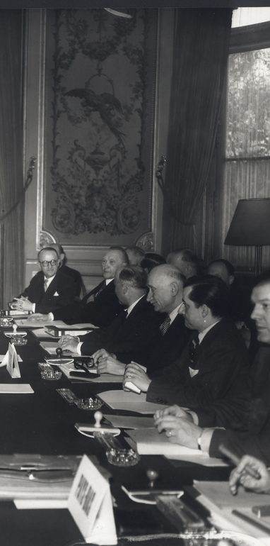
The EUROPEAN UNION
OVERVIEW
European Union at a glance
The European Union brings together 27 countries in a political and economic project that began in 1951 as the Coal and Steel Community and gradually expanded through new treaties, institutions, and members.
Built on the idea that economic cooperation could secure peace and rebuild post-war Europe, the Union evolved into a broad supranational structure with shared policies and common decision-making.
What the EU represents today
Today, the EU stands as a major global economic actor with growing political and security relevance, supported by a single market enabled through the Customs Union, the Schengen Area, and the Euro.
Current context
The EU continues aim to manage major geopolitical and economic challenges, including the aftermath of Brexit, tense relations with Russia, and increasingly complex trade dynamics with the United States and China.
After Croatia’s accession in 2011, enlargement slowed, but the current geopolitical landscape has revived interest in membership, with Moldova, Ukraine, and Georgia emerging as prominent candidates.
Importance
EU-level decisions remain highly influential, as roughly half of the legislation in member states stems directly from policies adopted at EU level.
The EU plays a central role in shaping the chemicals industry, as its legislation directly determines how substances can be produced, marketed, and used; frameworks such as REACH and CLP create harmonised rules on registration, authorisation, classification, and labelling, giving the EU significant influence over both market access and industrial practices across Europe.

Slide 5

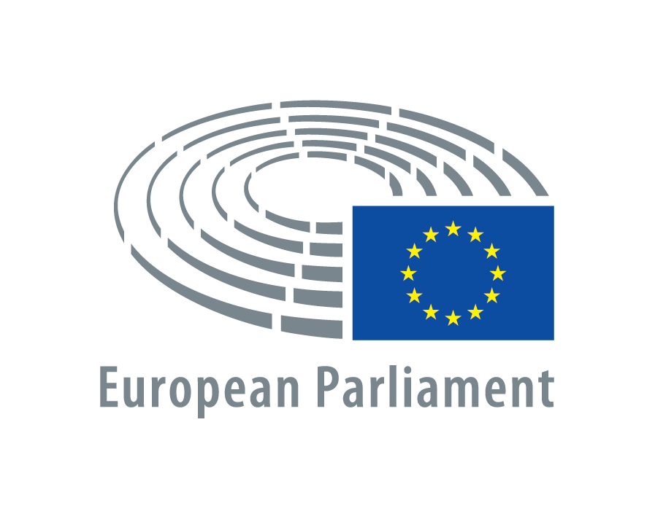

The eu institutions
OVERVIEW
The European Commission is the EU’s main executive body. It proposes legislation, upholds EU treaties and ensures Member States apply EU law and policies. The European Commission manages the EU's budget and negotiates international agreements on behalf of the EU.
It is composed by a College of Commissioners, each of them representing one EU member state, and in charge of a portfolio (e.g. energy, defence, tech, health).
The current President of the European Commission is Ursula von der Leyen, whose mandate will finish in 2029.
The European Commission
The European Parliament is one of the two European co-legislators, with the power to adopt and amend legislative proposals coming form the European Commission.
The Members of the European Parliament (MEPs) are directly elected by voters in all Member States to represent people’s interests with regard to EU law-making and to make sure other EU institutions are working democratically.
It counts with 720 MEPs seated in 8 political groups. Their work is divided in thematic Committees and Delegations, which are in charge of the relations with non-EU countries.
The current President of the European Parliament is Roberta Metsola, whose mandate will finish in 2027.
The European Parliament
The European Council is the EU institution that defines the general political direction and priorities of the European Union. It does not negotiate or adopt EU laws.
The members of the European Council are the heads of state or government of the 27 EU member states, the European Council President and the President of the European Commission.
The current President of the European Council is António Costa, whose mandate will finish in 2027.
The European Council

Slide 6



The eu institutions
OVERVIEW
The Council of the European Union (or simply Council) represents the member states' governments and is where national ministers from each EU country meet to negotiate and adopt EU laws. Together with the European Parliament, is the second European co-legislator.
They have a Permanent Representation in to the European Union, whose public servants represent the interests of their national governments in the recurrent thematic Working Parties and Committees.
The member states take it in turns to chair Council meetings for six months. Cyprus currently holds the Council presidency and will do so until 30 June 2026.
The Council of the European Union
The European Court of Justice constitutes the judicial authority of the European Union, working in cooperation with the courts and tribunals of the Member States. Its mission has been to ensure that "the law is observed" "in the interpretation and application" of the Treaties.
It reviews the legality of the acts of the institutions of the European Union, ensures that the Member States comply with obligations under the Treaties, and interprets European Union law at the request of the national courts and tribunals.
The President of the European Court of Justice is Marc van der Woude, whose mandate will finish in 2028.
The European Court of Justice
There are plenty of bodies that support the legislative process in the European Union. Two of the most relevant ones are the European Economic and Social Committee and the European Committee of the Regions, whose opinions influence the direction of the legislative debate.
The European Economic and Social Committee (EESC) is the voice of organised civil society in Europe. It represents employers, workers and civil society organisations. Its President is Séamus Boland, whose mandate will finish in 2028.
The European Committee of the Regions (CoR) is the assembly of local and regional representatives that provides sub-national authorities with a direct voice within the EU's institutional framework. Its President is Kata Tüttő, whose mandate will finish in 2027.
Other bodies

Slide 7

The eu institutions
Triangular Relation:
European Commission = General Interest = Executive
European Parliament = EU citizens’ interest = Legislator
Council of the European Union = EU Member States’ interests = Legislator
European Council = EU Member States’ interests = Political
OVERVIEW
Mandates
Advisory Bodies:
Judiciary Authority:
Legislative proposals & negotiation (dotted)
Ideas & priorities (dotted)
Scrutiny & Oversight

Slide 8
The legal instruments
OVERVIEW
The EU relies on a range of legal instruments to shape and implement its policies. These instruments differ in their legal force, how they apply, and the degree of flexibility they give to Member States. Together, they ensure that EU legislation is both effective and adaptable across diverse national systems.
Regulation | A fully binding legislative act that applies directly and uniformly in all Member States without the need for national transposition.
Directive | A fully binding legislative act introducing a goal that all EU countries must achieve. It is up to the individual Member State to devise their own laws on how to reach these goals.
Decision | A binding act directed at specific Member States, companies, or individuals, and directly applicable only to those addressed.
Recommendation | A non-binding instrument through which EU institutions encourage certain actions or approaches without creating legal obligations.
Opinion | A non-binding statement expressing an institution’s assessment or viewpoint on a particular issue, often used to guide political or legislative discussions.
Delegated act | A technical act adopted by the European Commission that serve to amend or supplement the non-essential elements of the legislation.
Implementing act | A technical act laying down detailed rules to ensure that EU laws are applied uniformly and consistently across the Union.

Slide 9
the eu legislative process
OVERVIEW
Formulation
Adoption
Implementation
Secondary Legislation
POLICY INPUTS
The European Commission conducts impact assessment, meets with stakeholders and conducts public consultations (not mandatory).
PARLIAMENT ADOPTS ITS POSITION
The file is referred to a Committee responsible. The Committee drafts a report, which is then submitted to a plenary vote to confirm the final position of the Parliament.
TRILOGUE NEGOTIATIONS
Co-legislators (Parliament and Council) and Commission negotiate to find an agreement on the text.
DELEGATED AND IMPLEMENTING ACTS
The Commission publishes secondary legislation, which aims at supplementing the act or at helping the uniform implementation of the law.
COMMISSION ADOPTS PROPOSAL
The European Commission adopts a proposal (Regulation or Directive) and sends it simultaneously to the Parliament and the Council for scrutiny.
COUNCIL ADOPTS ITS POSITION
Member States agree on their stance and adopt a General Approach.
TRANSPOSITION
Member States transpose the legislation into their national law (in the case of a directive) or apply the Regulation.

Slide 10

NOVE
Hôtel Tassel
6, rue Paul Emile Janson
1000 Brussels
Belgium
T : + 32 2 588 40 80
F : +32 2 503 09 60
info@nove.eu

